Slide 1
TDD in TypeScript
Test Driven Development
DEV3LSOLUTIONS.COM
Notes:
8 hours – 1 hour lunch break
7 hours = 420 minutes
10-minute break every hour
- Try to break on exercise to catch up anyone

Slide 2
Day Two
Notes:
10m : 10m
Socialize

Slide 3

recap
Notes:
15m : 25m
Utilize practice problems (aka Katas) to develop a baseline level of experience with TDD
Fizz Buzz
Roman Calculator
# Three Laws of Test Driven Development
- You are not allowed to write any production code unless it is to make a failing unit test pass.
- You are not allowed to write any more of a unit test than is sufficient to fail; and compilation failures are failures.
- You are not allowed to write any more production code than is sufficient to pass the one failing unit test.
Fake it till you make it
# ZOMBIES
Z - Zero
O - One
M - Many
B - Boundary Behavior
I - Interface Definition
E - Exercise Exception Behavior
S - Simple
S - Single Responsibility Principle
O - Open / Closed => Open for extension, closed for modification
L - Liskov Substitution => shape.area :: rectangle.area : square.area : circle.area
I - Interface Segregation
D - Dependency Inversion
D - Don't
R - Repeat
Y - Yourself
Y - You
A - Ain't
G - Gonna
N - Need
I - It
Lot of hard work and discipline – shift quality left

Slide 4
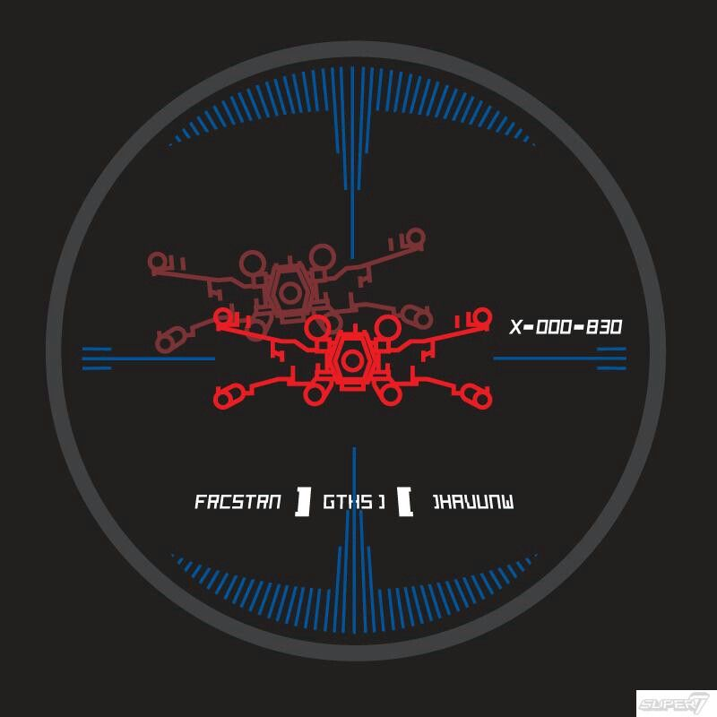
Course Objectives
Summarize the value of TDD
Use TDD to solve Katas
Integrate TDD Into Daily Work
Recognize the benefit of writing clean, maintainable code
Notes:
5m : 30m
How are we doing?

Slide 5

TDD Costs (Perceived)
Takes twice as long
Maintain test and code
Reduced ability to quickly produce quick and dirty prototypes
Notes:
5m : 35m
Takes twice as long
- Reality: easily saves more time
Maintain test and code
- Reality: beats maintaining written detailed docs
Not all that valuable - tough work is in the “wiring”
- Reality: not if classes are designed correctly in the first place
Time wasted on fixing “brittle tests”
Reduced ability to quickly produce quick and dirty prototypes
- Hacker Hat vs Craftsman Hat
- Quality tuned to context

Slide 6
TDD Costs (Real)
Initial learning curve
Continual Learning: How do I test X?
Can promote overconfidence
Maintaining tests can be considerable work
Notes:
5m : 40m
If you have never done TDD, and you go back to work next week and say – from now on I am doing ONLY TDD… probably in for a bad time Greenfield projects and/or well architected projects this may work, but unfortunately most of us have to deal with rough legacy systems
There are situations that are difficult to test – external devices and api’s

Slide 7
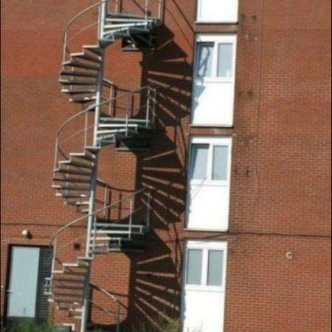
Two Unit Tests No Integration Tests
Notes:
5m : 40m
TDD helps prevent errors in specification, but it often does not look at the integration of those specifications into the system as a whole
There are no silver bullets

Slide 8
TDD Rewards
Higher confidence levels - Continual feedback; Pavlovian response - Ease introduction of new functionality - Allows for refactoring with impunity
Continual progress - Add value every programming session, every few minutes - Avoid going too astray
Notes:
5m : 45m
What is the business value of “higher confidence levels”? - agility
Anyone here ever been stuck on a bug for what seems like hours, or days, when it turns out it was a single line of code that needed changed? - no need to understand the entire system to make a change, tests will catch what is broken

Slide 9
Kata: Bowling
04_bowling
Notes:
45m : 90m
Problem Description
Create a program, which, given a valid sequence of rolls for one line of American Ten-Pin Bowling, produces the total score for the game. Here are some things that the program will not do:
- We will not check for valid rolls.
- We will not check for correct number of rolls and frames.
- We will not provide scores for intermediate frames.
Depending on the application, this might or might not be a valid way to define a complete story, but we do it here for purposes of keeping the kata light. I think you’ll see that improvements like those above would go in readily if they were needed for real.
We can briefly summarize the scoring for this form of bowling:
- Each game, or “line” of bowling, includes ten turns, or “frames” for the bowler.
- In each frame, the bowler gets up to two tries to knock down all the pins.
- If in two tries, he fails to knock them all down, his score for that frame is the total number of pins knocked down in his two tries.
- If in two tries he knocks them all down, this is called a “spare” and his score for the frame is ten plus the number of pins knocked down on his next throw (in his next turn).
- If on his first try in the frame he knocks down all the pins, this is called a “strike”. His turn is over, and his score for the frame is ten plus the simple total of the pins knocked down in his next two rolls.
- If he gets a spare or strike in the last (tenth) frame, the bowler gets to throw one or two more bonus balls, respectively. These bonus throws are taken as part of the same turn. If the bonus throws knock down all the pins, the process does not repeat: the bonus throws are only used to calculate the score of the final frame.
- The game score is the total of all frame scores.
More info on the rules at: [How to Score for Bowling](https://www.topendsports.com/sport/tenpin/scoring.htm)

Slide 10
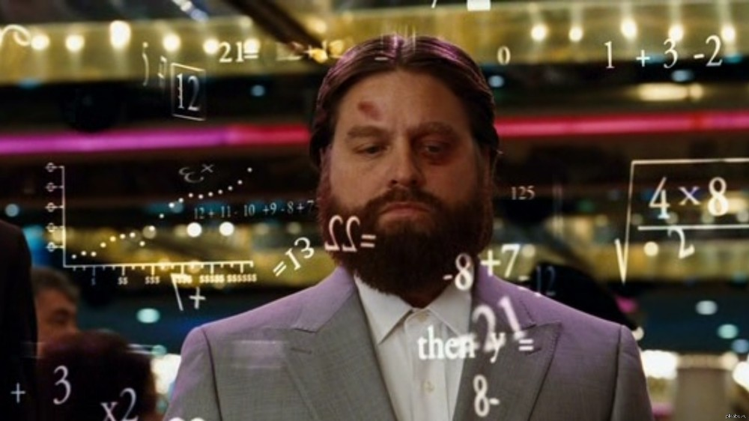
Review
Notes:
15m : 105m

Slide 11

BREAK 10:55
Notes:
10m : 115m

Slide 12

TDD So Far...
How does it help? - Based upon what you’ve learned so far Testing all the time Design all the time - Build classes in isolation - Consistently adapt to changing requirements That’s only part of it…
Notes:
5m : 120m
We have done four separate excercises… for some, this may be the first unit tests ever written
What does it feel like we are missing?

Slide 13
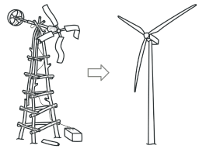
Refactoring
Restructure (the source code of an application or piece of software) to improve operation without altering functionality
Notes:
5m : 125m
Has anyone here misued, or heard someone else, the term “refactoring”?
Ensure all previous tests are still passing
Clean up the code without adding new functionality
Address readability, naming
Remove duplication

Slide 14
Refactoring
Ensure code has optimal design always - Another way to do “agile” design
Entropy is unavoidable - Deal with it all along product lifecycle Code transformations, not performance optimizations Take small, safe steps The third, critical leg of the TDD cycle
Notes:
5m : 130m
Code changes during refactoring should NOT change external behavior of code

Slide 15
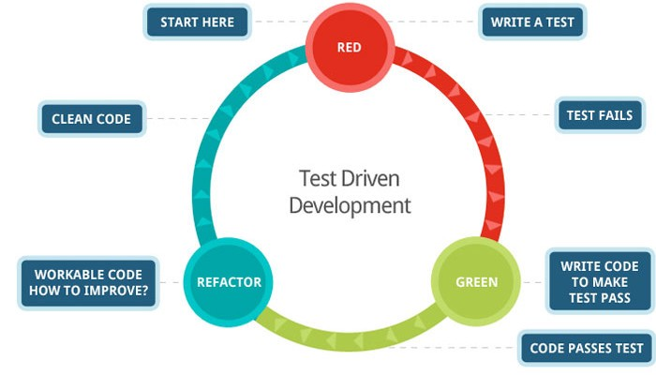
Red, Green, Refactor
Notes:
5m : 135m
We have been working on the Red-Green loop, but it feels like something is missing?
How does Refactoring tied into TDD?

Slide 16
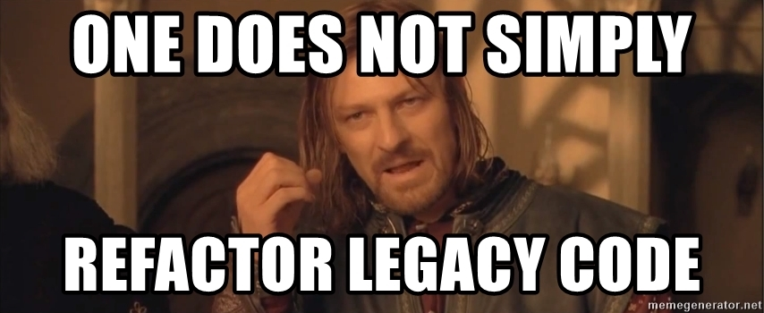
Notes:
0m : 135m
So how do we do this in production code?

Slide 17
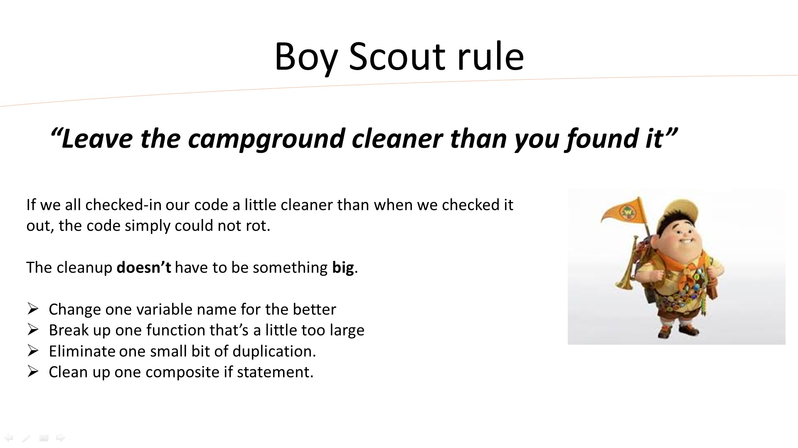
Notes:
5m : 140m

Slide 18
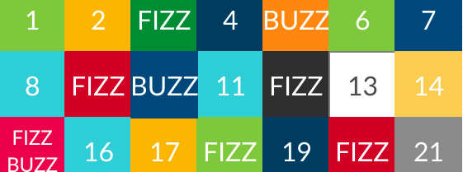
Refactoring Fizz Buzz
What if we wanted to make it so that multiples of seven go “Pop”?
Based upon our current implementation, having to add another command violates the open closed principle…
Notes:
5m : 145m
How could we refactor our code such that this is possible?
What if not just multiples of 3 or 5, we decided if the number has a 3 or 5 in it, then it should Fizz or Buzz?

Slide 19
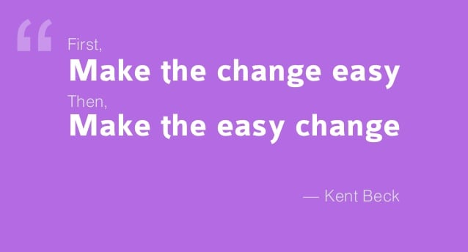
Notes:
5m : 150m
Is anyone here familiar with design patterns?
Which design patterns could we use such that we could refactor a FizzBuzz solution to allow for Pops?

Slide 20
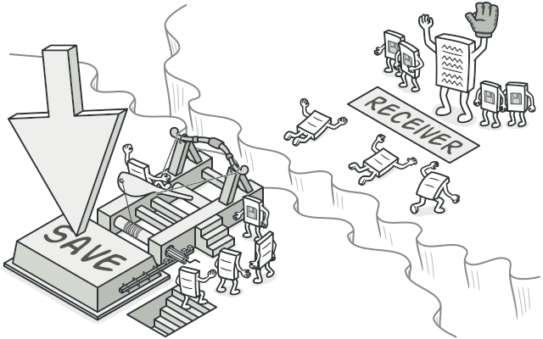
Abstract Factory
https://refactoring.guru/
Command
05_fizz_buzz_command
Notes:
20m : 170m
Abstract Factory is a creational design pattern that lets you produce families of related objects without specifying their concrete classes.
- Encapsulate object creation into its own single responsibility
Command is a behavioral design pattern that turns a request into a stand-alone object that contains all information about the request. This transformation lets you pass requests as a method arguments, delay or queue a request’s execution, and support undoable operations.
- Encapsulate object behavior
Start out with 100% code coverage
`yarn test:coverage`

Slide 21

Review
Notes:
5m : 175m
Was that different than how anyone else implemented their Fizz Buzz solution?

Slide 22

BREAK
Notes:
10m : 185m

Slide 23
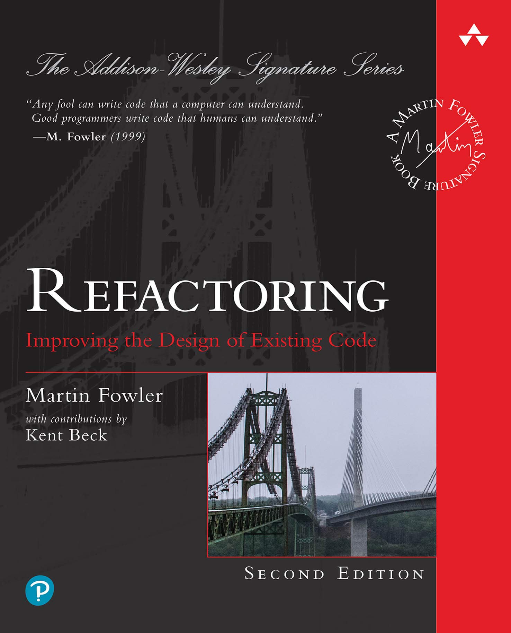
Notes:
2.5m : 187.5m
Has anyone read this book?
I have read the first edition, but the second edition is all in JavaScript!

Slide 24
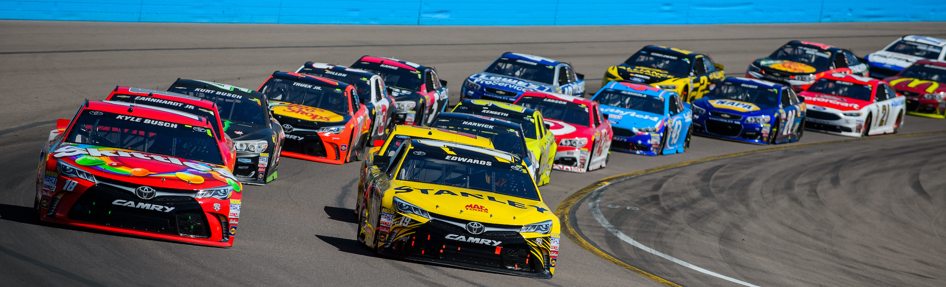
Refactoring Drivers
Code Smells
Classic design principles – SOLID, DRY, etc
Design Patterns (Gang of Four)
Notes:
7.5m : 195m
Does anyone here know what a code smell is?
- Have you ever stumbled across a piece of code that made you do a double take?
Why would we want to alter existing code to align with a design principle?
Can anyone here name a few design patterns, and talk about what problem it solves?

Slide 25
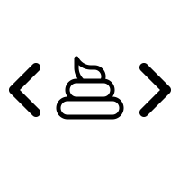
Code Smells
“Code smells are usually not bugs; they are not technically incorrect and do not prevent the program from functioning. Instead, they indicate weaknesses in design that may slow down development or increase the risk of bugs or failures in the future. Bad code smells can be an indicator of factors that contribute to technical debt.”
"When and Why Your Code Starts to Smell Bad"
2015 37th IEEE International Conference on Software Engineering (ICSE).
Notes:
2.5m : 197.5m
If it is not “technically incorrect”, why change it?

Slide 26
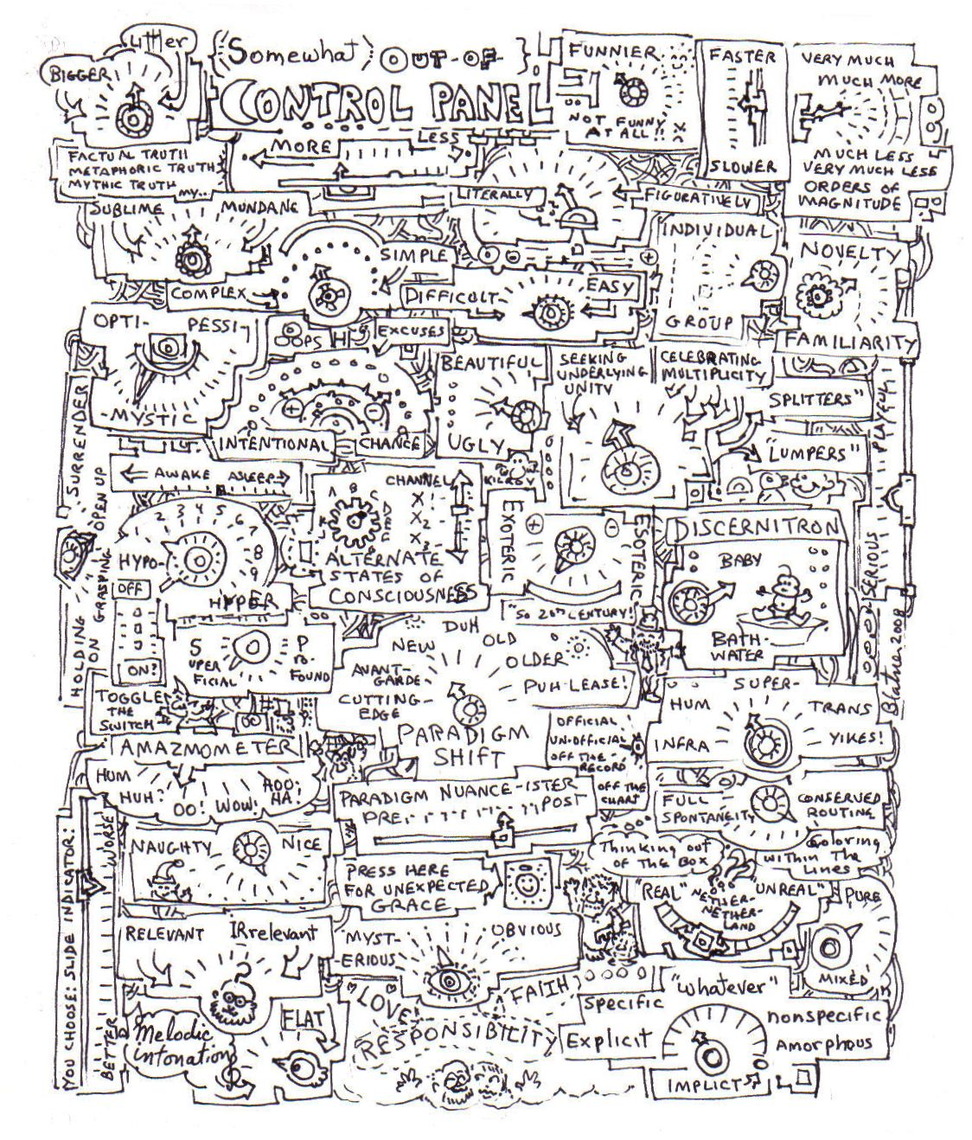
Recognize You Have a Problem
Long Method smell (Fowler)
Not very expressive, contains duplication (Simple Design)
Contains guiding comments (Simple Style)
Breaks the Single Responsibility Principle (Martin)
Notes:
7.5m : 205m
The first step in recovery is recognizing you have a problem
Why would each of these be a problem (aka a smell)

Slide 27
Application-level Smells
Duplicated code
Contrived complexity
Shotgun surgery
Notes:
5m : 210m
Duplicate code: Identical or very similar code exists in more than one location.
Contrived complexity: Forced usage of over complicated design patterns where simpler design would suffice.
Shotgun surgery: A single change needs to be applied to multiple classes at the same time.

Slide 28
Class-level Smells
Large class
Feature envy
Inappropriate intimacy
Excessive use of literals
Cyclomatic complexity
Notes:
5m : 215m
Large class: a class that has grown too large. See God object.
Feature envy: a class that uses methods of another class excessively.
Inappropriate intimacy: a class that has dependencies on implementation details of another class.
Excessive use of literals: these should be coded as named constants, to improve readability and to avoid programming errors.
Additionally, literals can and should be externalized into resource files/scripts, or other data stores such as databases where possible, to facilitate localization of software if it is intended to be deployed in different regions.
Cyclomatic complexity: too many branches or loops; this may indicate a function needs to be broken up into smaller functions, or that it has potential for simplification.

Slide 29
Method-level Smells
Too many parameters
Long method
Excessively long identifiers
Excessively short identifiers
Excessive return of data
Excessively long line of code
Notes:
5m : 220m
Too many parameters: a long list of parameters is hard to read, and makes calling and testing the function complicated.
It may indicate that the purpose of the function is ill-conceived and that the code should be refactored so responsibility is assigned in a more clean-cut way.
Long method: a method, function, or procedure that has grown too large.
Excessively long identifiers: in particular, the use of naming conventions to provide disambiguation that should be implicit in the software architecture.
Excessively short identifiers: the name of a variable should reflect its function unless the function is obvious.
Excessive return of data: a function or method that returns more than what each of its callers needs.
Excessively long line of code: A line of code which is so long, making the code difficult to read, understand, debug, refactor, or even identify possibilities of software reuse.

Slide 30

Refactoring Tips
Don’t refactor and change behavior simultaneously
Always run tests - If tests aren’t available, take only safe proven steps
Never skip the third leg of the TDD cycle - Avoid having to ask permission - Refactoring is part of your development process
Notes:
5m : 225m
What are ”safe proven steps”?

Slide 31

Read by Refactoring
Rename
Inline
Extract Method
Introduce Local Variable
Introduce Parameter
Introduce Field
Notes:
5m : 230m
Read by Refactoring is a technique discussed and taught by Arlo Belshee (@arlobelshee) at Industrial Logic. Using this technique, reading code – to figure out what it does, to estimate the effort to modify it, etc. – turns into active refactoring of the code. You read the code by modifying it, nudging it into a clearer, more readable state. The key is you are leveraging your IDE’s built in refactoring functions and mastering the keyboard shortcuts in such a way that your insights of how the code can be improved translate immediately into modification of the code.

Slide 32
Incremental Change
Look at something
Have an insight
Write it down (in code)
Check it in
Notes:
5m : 235m
The key to read by refactoring is the additive benefits of many small changes. Legacy code or unfamiliar code is too complex to allow discovery of big insights into how to make it better. Instead, small changes, made safely, step by step, transform code into a better state.
This is a tight, quick, loop – limited only by the speed at which you have insights and refactor the code. Keep in mind, each loop is a small step. Maybe the first insight is to rename a method so it better describes what it does. That’s a check-in. Next, you inline a variable to increase readability. That’s a check-in. You’ll find yourself doing dozens of check-ins per hour. Each of them small, and each of them safe. Each of them easily rolled back if something goes wrong or you need change direction.

Slide 33
Benefits
Rapid Development
Every time you read code; you improve it
Refactoring becomes ingrained in the culture
Greater agility
Notes:
5m : 240m
Rapid Development – Safe changes can be merged directly to master without code reviews and QA (mostly).
Every time you read code; you improve it. Examining code is no longer passive – you gain understanding of how it works, and you leave it better than you found it.
Refactoring becomes ingrained in your culture – a part of your daily development flow and no longer a separate task you hope to get to some day.
This new-found ease with refactoring leads to lower costs for refactoring and thus lower costs for design mistakes/changes. This allows for greater agility.

Slide 34

BREAK 1:00
Notes:
10m : 250m

Slide 35
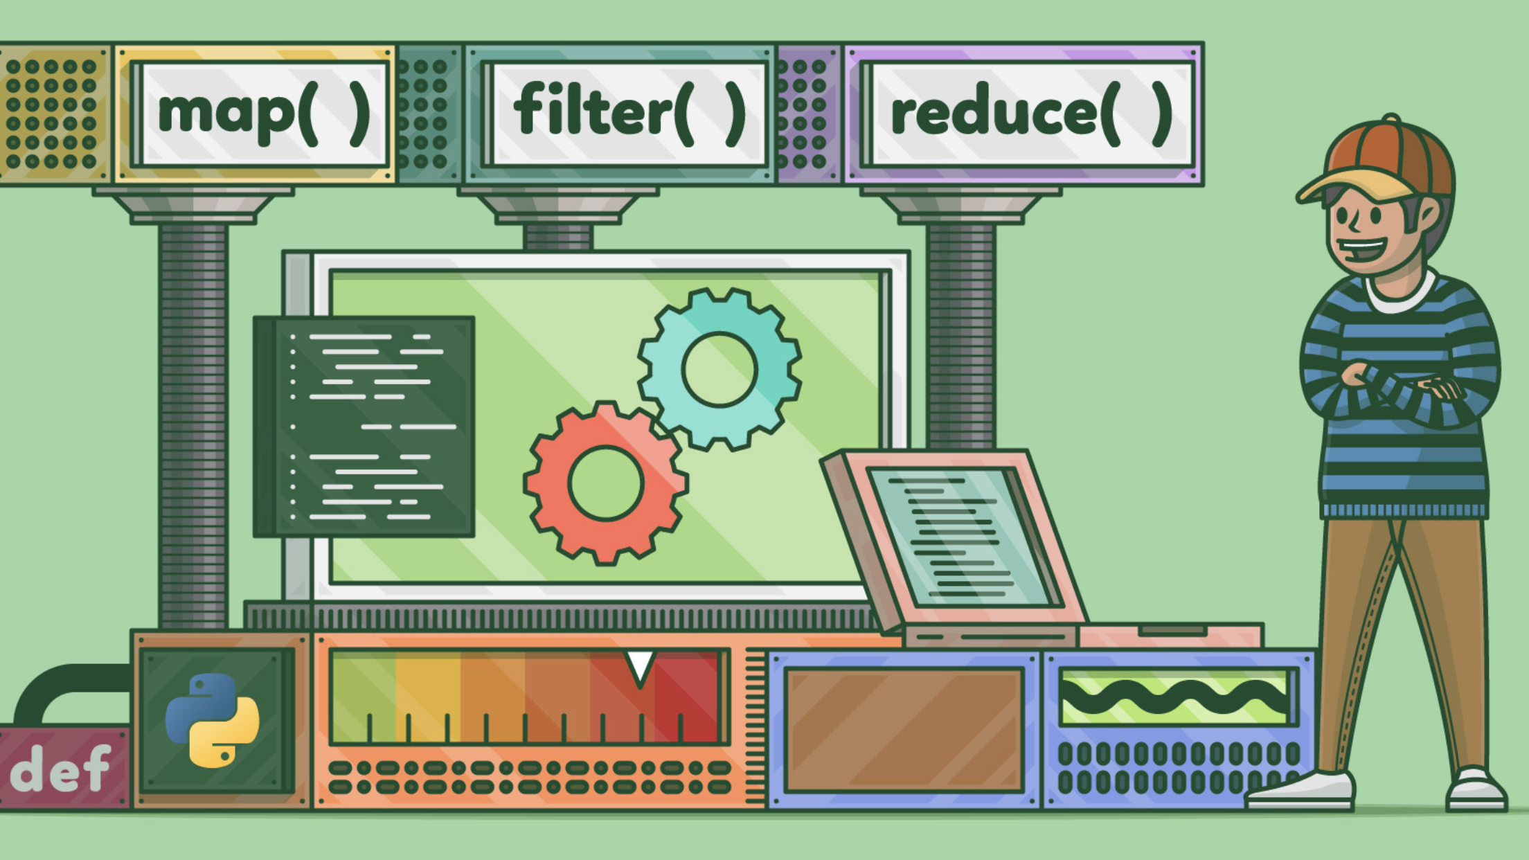
Kata: Fizz Buzz
06_fizz_buzz_functional
Notes:
15m : 265m
http://codingdojo.org/kata/FizzBuzz
Since we did this one earlier, it should go quicker – right?
The best way to practice TDD, is to start the day off with a small timeboxed exercise – the purpose is to practice, NOT to finish FizzBuzz is pretty quick, so we are going to timebox this at 15m
This time, no looping

Slide 36

Review
Notes:
5m : 270m
How was that implementation different than the rest of our Fizz Buzz solutions so far?

Slide 37
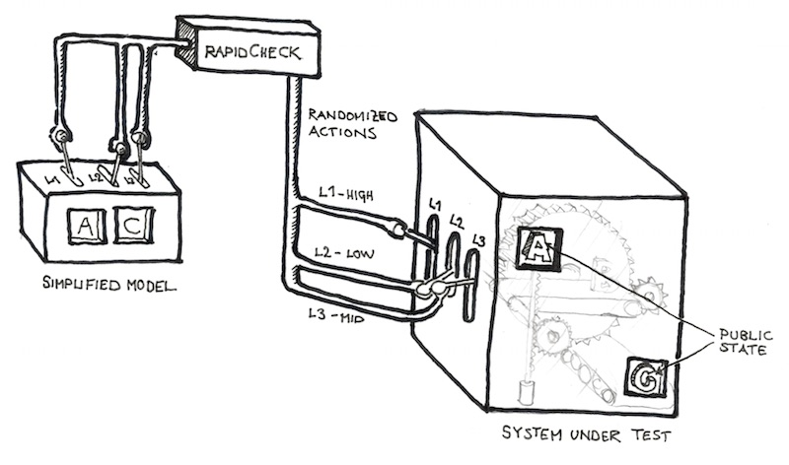
SUT – System Under Test
The thing we’re currently writing Unit Tests for
Can have 1 or more dependencies (Fowler calls them “collaborators”)
Notes:
2.5m : 267.5m
When we say unit test, what are testing?
We want to create a shared vocabulary such that everyone understands what the “system” is In addition, when we have dependencies, we can reference them as “collaborators” to the system

Slide 38
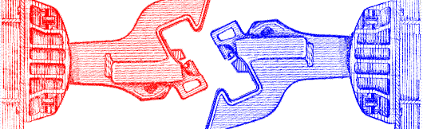
Dependencies, Decoupled...
You want to isolate the SUT as much as possible!
Building an entire app object graph just for Unit Testing is not practical
Databases should never be a part of a Unit Test!
Notes:
2.5m : 270m
Loose Coupling Saves Lives!

Slide 39
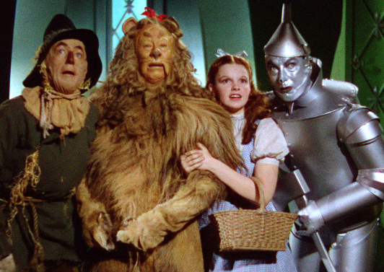
Mocks and Fakes and Stubs, Oh My!
All the same thing: objects that simulate the behavior of real objects
This is how we decouple the “collaborators” from the SUT
Allows us to go beyond simply verifying just the state of the SUT
Opens the door to let us verify the behavior of the SUT

Slide 40
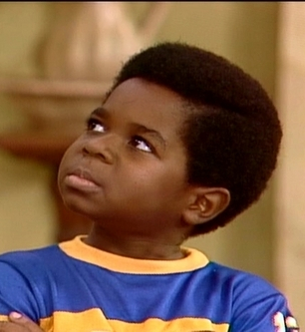
Mocks vs Stubs vs Fakes
Stubs can be thought of having minimalistic behavior – just enough to allow the object under test to execute the test
A Mock is like a “smart” Stub in that the test will also verify that the object under test calls the mock as expected
A Fake has business behavior. You can drive a fake to behave in different ways by giving it different data
Notes:
Welcome to a controversial topic!
Wha'choo talkin' 'bout, Willis?

Slide 41
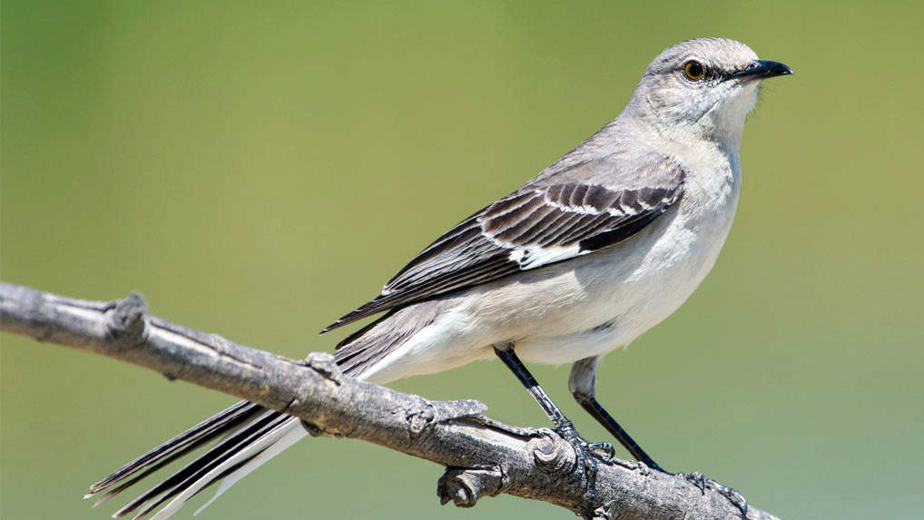
Mocks – How to use them
Most languages have a mocking framework available to use
Mocks and Stubs are easily created with a mocking framework
A Fake is usually easier to code by hand, but can still be done with a mocking framework

Slide 42

Kata: Widget Mock
07_widget_mock
Notes:
30m : 235m
http://codingdojo.org/kata/FizzBuzz
Since we did this one earlier, it should go quicker – right?
The best way to practice TDD, is to start the day off with a small timeboxed exercise – the purpose is to practice, NOT to finish FizzBuzz is pretty quick, so we are going to timebox this at 15m
This time, no looping

Slide 43

SOFTWARE DESIGN & TDD 2:45p

Slide 44

Software Development Activities
Software development requires:
Analysis, design, coding, testing, review, documentation, planning, deployment, etc.
Absence of any one of these is hacking
Waterfall attempts to serialize these
Agile Solution: Learn to do all activities all the time

Slide 45
Upfront Design
We still do it
Mostly at planning meetings
But with less details
Design insights often only occur when coding
UML Sketches
“Inception” level diagrams
Help Solve the problem but don’t completely specify the code

Slide 46
Design
Design principles and patterns
- vs -
Simple design
BDUF (Big Design Up Front)
- vs -
Emergent design

Slide 47
SIMPLE EVOLUTIONARY DESIGN

Slide 48

Simple Design
Runs all tests
No duplication
Expresses intent
Minimal number of classes & methods

Slide 49
Simple Design
Implies use of TDD
TDD promotes “tell don’t ask”
TDD pushes you to think about “how do I test this class in isolation?”
Minimizes coupling: the core of good OO design
Implies the system works as designed
Automated tests prove it

Slide 50
Simple Design: Expresses Intent
Directly relates to maintenance costs
Core idea behind design patterns
Communicating ideas using common terms / solutions
Promotes single responsibility principle

Slide 51
Simple Design: Minimal Number of Classes & Methods
Prevents over design
You don’t build things into the system that aren’t needed
Stopgap measure
Sometimes methods and classes don’t pull their own weight

Slide 52
It is Agile Software Design!
“Just enough” up-front design
Constant test-first unit testing
Constant attention to design impacts
Ruthless refactoring
It’s only code!
Malleable
Keep as clean as possible to ease addition of new features

Slide 53
Documentation Artifacts
Cost money!
Introduce into plan and estimate
Make executable where possible
Unit tests can supplant code specs, heredocs, design docs
Acceptance tests can supplant use cases, requirements docs

Slide 54
OTHER CONSIDERATIONS

Slide 55

How Big is a Test Method?
Multiple asserts might be a code smell
Could be too much in one test
Test functionality, not methods
Could suggest deficient design
Look to decouple behavior of classes under test
Underlying code may be linked
Look to combine into common assert method
One assert / test is a goal, not a rule

Slide 56
How Big is a Test Class?
Generally one test class per production class
But you can create more than one if necessary...
Organize around common setup
Need for these multiple test “fixtures” might suggest the need for a redesign

Slide 57
The 10 Minute Rule
TDD promotes consistent pacing
Expect a green bar at least every 10 minutes
Otherwise you kill the pace
Resist firing up the debugger on your code
A good tactic:
Discard all new code since the last green bar
Start over, taking even smaller steps

Slide 58
10 Minute Rule Implications
Tests must run fast
Rapid feedback is critical to TDD
Many TDD systems run thousands of tests in under 3 minutes

Slide 59
If Your Tests Run Sloooooww
Look at pervasive bad dependencies
Usually Database, File or other external IO
Improve design
Corral Data Access code
Introduce mocking where needed
Concession: run subsets of tests
Run at the largest possible scope
Isolate certain kinds of tests
Increases Risk

Slide 60
Testing Private Behavior
Often suggests need for redesign
Private methods become public tested methods on another class
If absolutely necessary, relax access specifier

Slide 61
Testing Private Data
Verifying behavior requires inspecting state
Sometimes you wouldn’t normally expose this state
Relax access specifier
No worries - we have tests!

Slide 62
LEGACY CODE & TDD

Slide 63
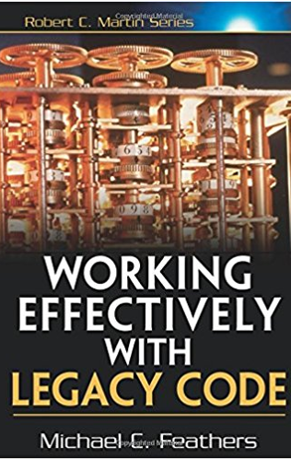
It’s a Catch-22
Existing systems do not have tests
We need tests in order to change code
In order to write tests, we often need to change code
Notes:
What is Legacy Code? Michael Feathers defines it as: code without tests
approval tests
Code seams

Slide 64

Introducing Unit Tests to Legacy Code
Identify change points
Requires good understanding of system design
Find test points
Based on analysis of effects
Break dependencies using safe refactoring techniques
Write tests
Make changes and refactor
Notes:
approval tests

Slide 65
Effects Analysis
Identify method that will change
If it has a return value, examine its callers
Determine if it modifies any values
If so, examine methods that use those values
Also examine methods that use those methods
Make sure you examine super/subclasses
Examine parameters to the methods
Examine global variables and static data modified in any of the identified methods
Notes:
approval tests

Slide 66
Breaking Dependencies
Two reasons to break dependencies when putting tests into place
To sense - when we can’t access computation results
To separate - when we can’t get code to run in a test harness
Primary technique - fake collaborators
Impersonate a collaborator of the class under test
Notes:
approval tests

Slide 67
Some Dependency Breaking Techniques
Break Out Method Object
Move a large method to new class
Local variables in original method become fields
Extract Interface
Create an Interface for some subset of methods
Create fake based upon this interface
Introduce Instance Delegator
Solves problem of “static cling”
Opposite of Expose Static Method
Notes:
approval tests

Slide 68
Day Three
Notes:
10m : 10m
Socialize

Slide 69
recap
Notes:
15m : 25m
Utilize practice problems (aka Katas) to develop a baseline level of experience with TDD
Fizz Buzz
Roman Calculator
Bowling
Widget Mock
# Three Laws of Test-Driven Development
- You are not allowed to write any production code unless it is to make a failing unit test pass.
- You are not allowed to write any more of a unit test than is sufficient to fail; and compilation failures are failures.
- You are not allowed to write any more production code than is sufficient to pass the one failing unit test.
Fake it till you make it
# ZOMBIES
Z - Zero
O - One
M - Many
B - Boundary Behavior
I - Interface Definition
E - Exercise Exception Behavior
S - Simple
S - Single Responsibility Principle
O - Open / Closed => Open for extension, closed for modification
L - Liskov Substitution => shape.area :: rectangle.area : square.area : circle.area
I - Interface Segregation
D - Dependency Inversion
D - Don't
R - Repeat
Y - Yourself
Y - You
A - Ain't
G - Gonna
N - Need
I - It
---
Code Smells
“Code smells are usually not bugs; they are not technically incorrect and do not prevent the program from functioning.
Instead, they indicate weaknesses in design that may slow down development or increase the risk of bugs or failures in the future.
Bad code smells can be an indicator of factors that contribute to technical debt.”
Refactoring
Restructure (the source code of an application or piece of software) to improve operation without altering functionality
- Implementation and Refactoring should be separate steps
Boy Scout Rule
Read by Refactoring
System Under Test (SUT)
- Isolate Collaborators
- Stubs, Mocks, and Fakes
Simple Design & Emergent Design
- Runs all tests
- No duplication
- Expresses intent
- Minimal number of classes & methods
TDD and Legacy Code… What is Legacy Code?
- Pin Down / Approval Tests
- Seams
- Break Dependencies

Slide 70
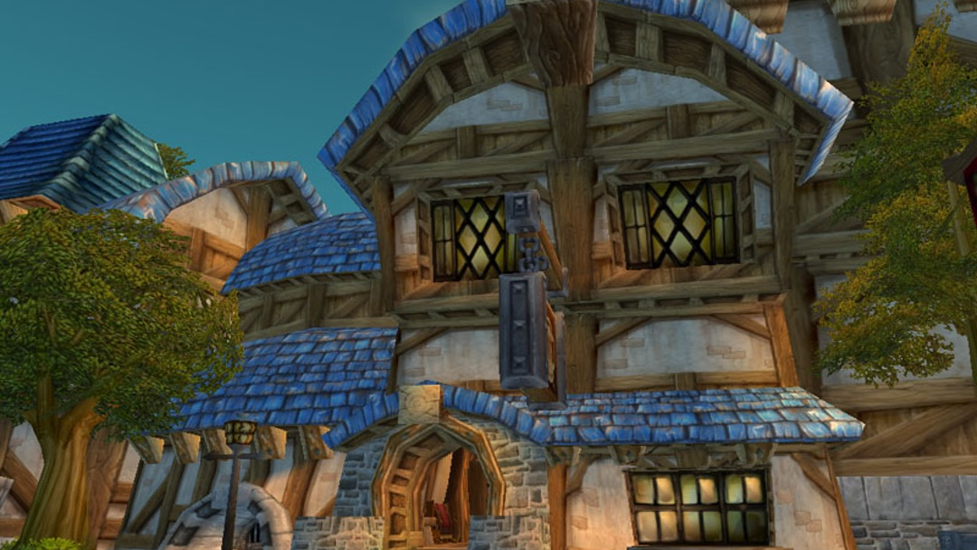
Kata: Gilded Rose
08_gilded_rose
Notes:
60m : 85m
https://github.com/emilybache/GildedRose-Refactoring-Kata/
The basic gist of the kata is this: Here is a piece of crappy legacy code that works.
The customer wishes you to implement and some constrains you need to adhere to.

Slide 71

Review
Notes:
15m : 100m
How was that one?
Anyone have any interesting solutions or findings?

Slide 72

THE END
Notes:
15m : 115m
Course Objectives:
Summarize the value of TDD
Use TDD to solve Katas
Integrate TDD Into Daily Work
Recognize the benefit of writing clean, maintainable code
Going Forward:
Team determines policy going forward
“All new code written using tests”
“Code without tests must be inspected”
Concentrate on legacy code that is causing problems or is the most difficult to modify
Consider pairing
Helps ingrain techniques
Ensures adherence
Final Thoughts: TDD is here to stay
A satisfying and enriching practice that can dramatically increase the quality of your application
Diligent adherence to practice is required to succeed
But the benefits are worth it
Retrospective?
10m : 125m
+ break (10m)

